Slide 1
The Visegrad Group –
Present and Future doc. PhDr. Lukáš Valeš, Ph.D.
University of West Bohemia
Region in the Development of Society 2025 – RESPO
Social, Political, Environmental and Public Administration Challenges
for the Visegrad Region
26th of September 2025, Brno

Slide 2
Historical beginnings
November 12, 1335 – 690 years ago – a meeting of the then superpowers of Central and Eastern Europe.
The driving force was the Czech prince Charles, later Charles IV. King Charles I Robert of Hungary, King John of Luxembourg of Bohemia, and King Casimir III the Great of Poland.
John of Luxembourg resigned his title of King of Poland in exchange for confirmation of his sovereignty over Silesiacooperation in political and commercial matters, and eternal friendship.Significant stabilization of Central Europe, which was to be unified first by the Luxembourgs (Sigismund of Luxembourg as King of Hungary and Bohemia) and then by the Habsburgs, including parts of Poland and western Ukraine.

Slide 3
The fall of communism as a new impetus for cooperation
The Visegrad Four (V4) was established on February 15, 1991, in Visegrad, Hungary, where Declaration on Cooperation between the then states of Czechoslovakia, Poland, and Hungary, signed by President Václav Havel and Prime Minister Marián Čalfa, President Lech Walesa and Prime Minister Jan Krzysztof Bielecki, and President Árpád Göncz and Prime Minister József Antall. The President of Czechoslovakia, Václav Havel, played an important role in the founding of the group and was seen as its "spiritual father." The main goal was to help these post-communist countries in their joint transformation and integration into European and Euro-Atlantic structures after the fall of communism. The signing took place in the medieval wine cellar of the royal palace—at that time, it was the only covered room in the royal palace that restorers were reconstructing. It was a harsh winter, with half a meter of snow outside. Warm air had to be blown into the cellar.

Slide 4
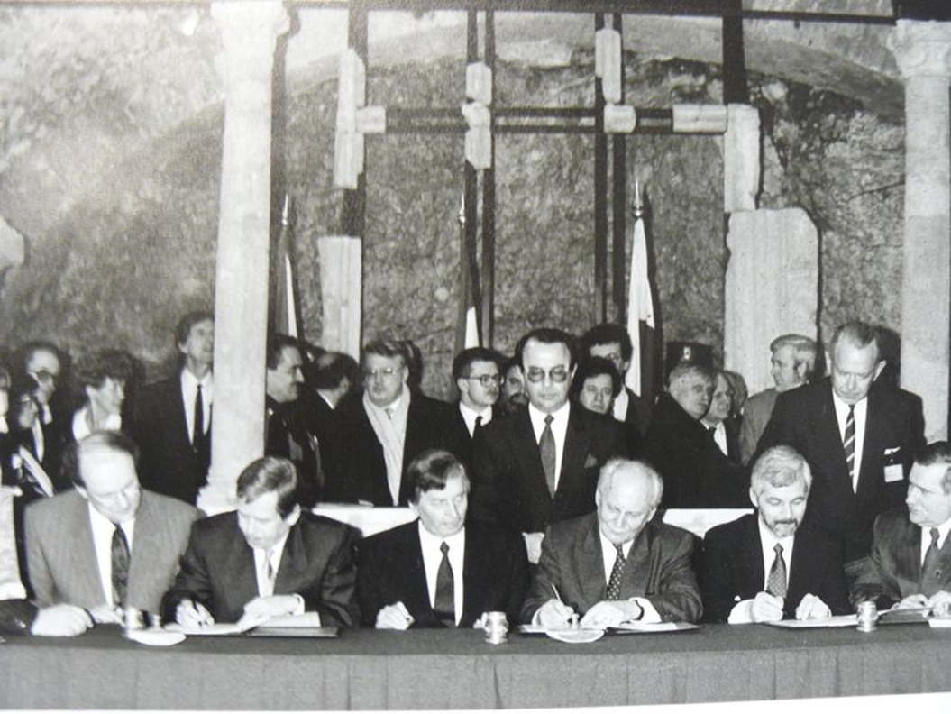
Heal the wounds of the past, break away from the East. Build on the cooperation of dissidents during the fall of communism
European and transatlantic perspective for Central Europe
The goal was achieved in 2004 with the accession of all four countries to the EU and NATO.

Slide 5
The present
Joining the European Union did not remove the economic or mental barriers of the Cold War – the huge differences between Central and Western European countries, particularly in terms of wages and living standards.
However, this has led to greater pragmatism and less willingness to accept ideological concepts of a multi-ethnic society or man-made climate change, much weaker progressivism, and greater strength of so-called traditional values, including patriotism and nationalism.
Despite EU membership, common themes – opposition to illegal and heterogeneous migration – fear of violence and destabilization, see France, Sweden, Germany.
Greater emphasis on transatlantic cooperation and US influence in Europe – given the Soviet and German experiences.

Slide 6
5. A shared past and experience of two totalitarian dictatorships, which the West lacks.
6. Common economic and political interests in the EU – production of cars with combustion engines – fight against emission allowances – against illegal migration – against excessive centralization of power, etc.
On the other hand, fundamental differences in foreign policy – Ukraine and Russia. Disputes between some more pro-European representatives (Poland – Tusk, Czech Republic – Fiala) and more patriotic representatives (Orbán, Fico) In the past, this led to a significant weakening of cooperation – on July 16, 2025 Poland definitively recalled its ambassador to Budapest – Prime Minister Viktor Orbán's government granted political asylum to Marcin Romanowski, former deputy Polish Minister of Justice, who was accused of corruption plus a Russian connection.

Slide 7
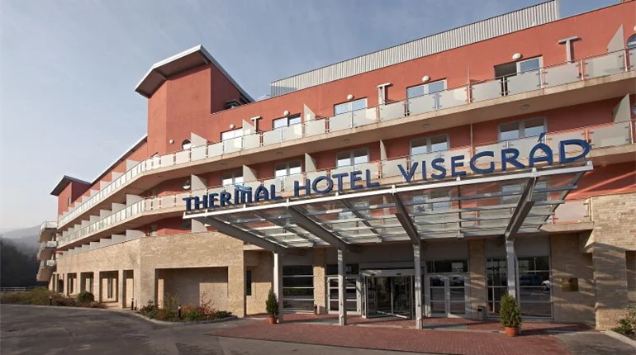
The card is turned over
Polish presidential election
New Polish president Nawrocki
Czech parliamentary election
Andrej Babiš – ANO

Slide 8
The future
The key to the future lies in developments within the EU
Poland's ambitions go even further: New president of Poland Nawrocki said in his first foreign interview with the Hungarian weekly Mandiner that closer cooperation within the V4 and the so-called Bucharest Nine (B9), which brings together nine countries on NATO's eastern flank - Czechia, Poland, Romania, Bulgaria, Estonia, Lithuania, Latvia, Slovakia, and Hungary."

Slide 9
The European integration process in deep crisis
This includes two key states and drivers of European integration:
France and Germany.
Enormous security problems that they are unable to tackle – illegal migration and enormous internal heterogeneity of the population, which cannot agree on basic principles.
Growing social tensions coupled with economic decline.
Germany has not grown for over two years, thanks to the implementation of the Green Deal, which has caused major problems with exports and energy prices
France – huge debt – €3.3 trillion – over 40 years of budget deficits

Slide 10
In both cases, the unwillingness (France) or inability (Germany) of political elites to address these issues, particularly economic ones.
A problem especially for the eurozone – all members are liable for the debts of other members.
Total aid to Greece – €334 billion
France alone €3.3 trillion!
Germany is also heavily indebted. The European Union – instead of addressing economic issues, the Commission continues to deal with climate change, armament, etc. Hundreds of billions of euros have been spent on climate change, but a large part of the European population is becoming increasingly poor and feels threatened at home. The collapse of the EU?

Slide 11
The collapse of the EU?
Tensions are rising, but no one is coming up with a solution.
The collapse of the EU may—but may not—be a scenario.
In that case, it will be necessary to restructure Europe. Nation states or regional alliances, or a combination (large states plus alliances) and rebuild a single European market. Or the existence of several larger markets side by side.
For example, the Visegrad Group plus its allies – Austria, the Baltic states, Romania, the Balkans, etc. The core of future European integration?

