Slide 1
CIRCLES A Framework for Youth Empowerment
Region in the Development of Society 2025 (RESPO)
Social, Political, Environmental and Public Administration Challenges
for the Visegrad Region
26th of September 2025, Brno, Czech Republic

Slide 2
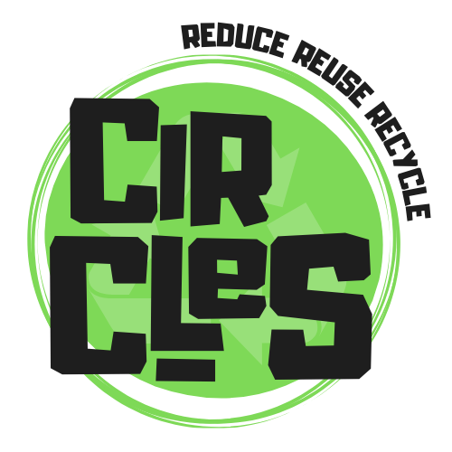
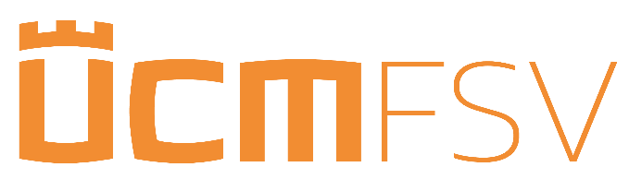





Circular Economy Integration, Resources, and Learning for Economic Sustainability
"Because change isn't just inevitable—it's recyclable!„
Field: Youth
Project Start Date: 01.09.2024
Project Total Duration: 23
Project End Date: 31.07.2026
Project Lump Sum: 250 000€
Consortium: Slovakia, Greece, Slovenia, Bulgaria

Slide 3
What's on the Agenda?
to support and supplement the education of young people in the developing field of circular economy and sustainable development;
to use digital tools for enhancing learning and stimulating active engagement with the topic of sustainability and climate change;
to create innovative and accessible, dynamic educational tools for young people in the field of circular economy;
to support critical thinking, digital literacy, active citizenship, the sense of entrepreneurship and social entrepreneurship in youth;
to raise awareness and promote active action to fight climate change in effective community-centered and community building ways

Slide 4
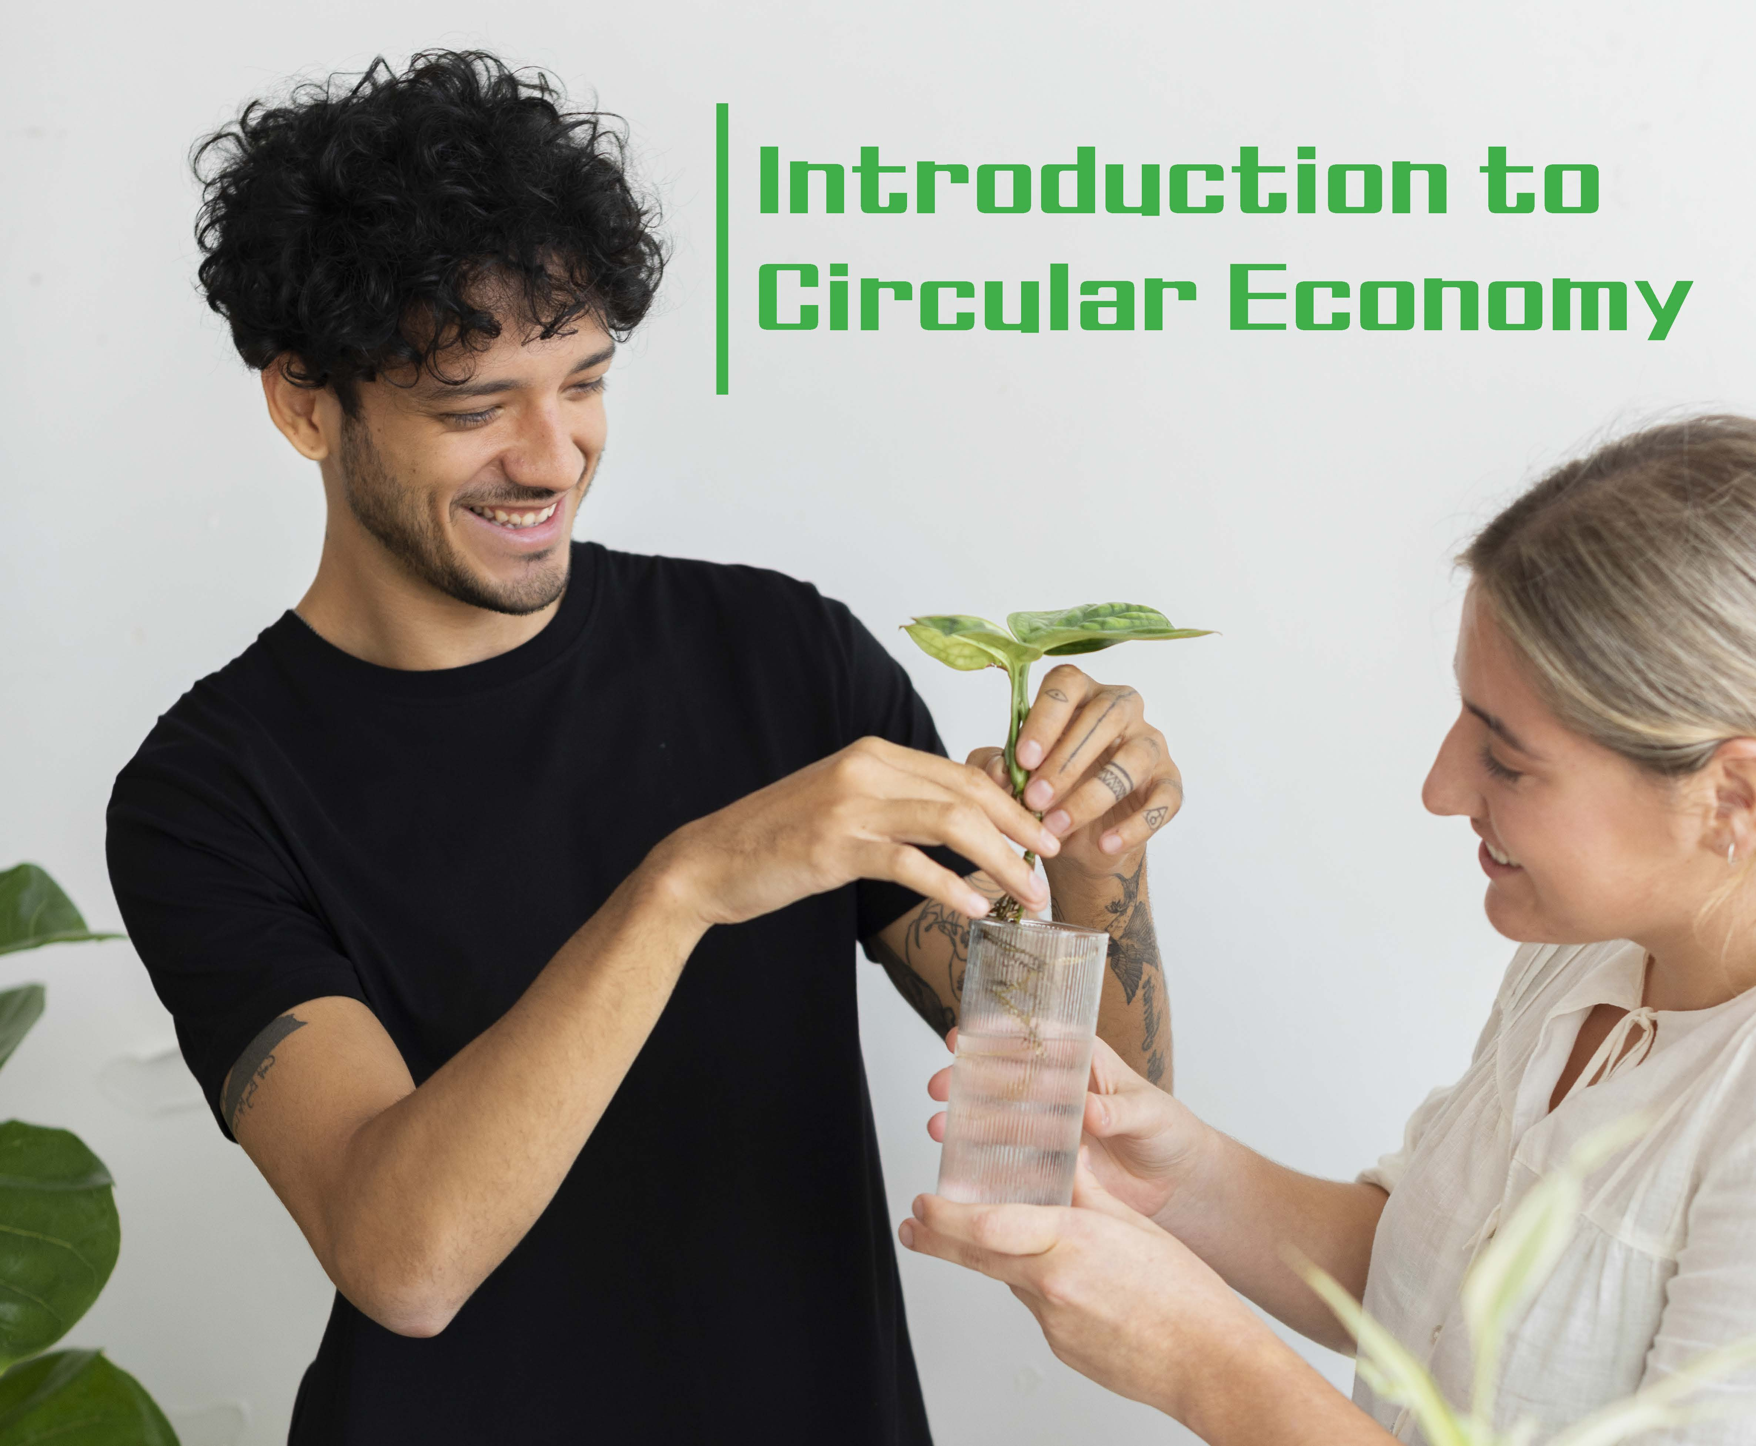
Why CIRCLES Matters – The Big Picture
Addresses global sustainability gaps in youth education
Tools: Gamified video game, curriculum, syllabus, community project, toolkits
Goals: Boost environmental awareness, digital literacy, active citizenship
Innovation: Holistic model blending theory, play, and real-world action

Slide 5
CIRCLES Methodology
Project's methodology is structured around three core, interconnected work packages that systematically translate its theoretical framework into concrete deliverables:
Gamification
design and development of the CycleQuest: Path to Sustainability video game.
the central element of the project’s gamification strategy, designed to immerse players in circular economy principles through interactive, problem-solving scenarios
Curriculum and Syllabus Development
formal and non-formal educational materials that will embed the project’s principles into existing learning systems
Experiential Learning via Community Projects
experiential learning, where the project moves from theory to practice

Slide 6
Gamification in Circular Economy
efficacy in increasing learner engagement, motivation and knowledge retention
gamification affects the engagement and learning behavior of university students
gamification can enhance student engagement in online learning, similar to how games do, and improve their skills
serious video games as a viable pedagogical device to teach complex systems thinking and dynamic decision-making processes
enhance digital literacy and active citizenship

Slide 7
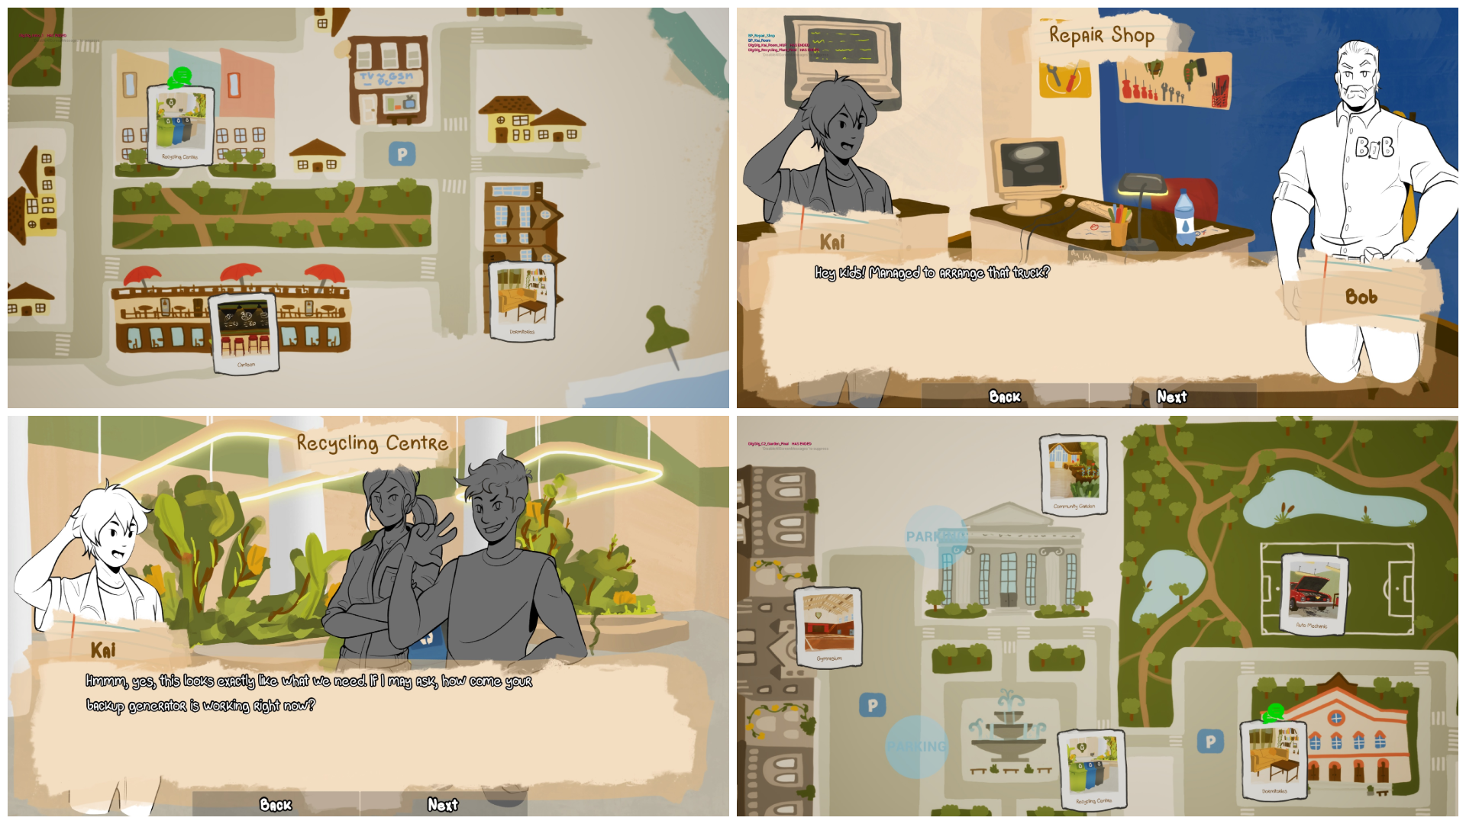

Slide 8
Curriculum and Syllabus Development
University Syllabus: Formal education for students in economics, social sciences, humanities.
the syllabus outlines a prospective academic course on circular economy, designed for theoretical and practical application
Youth Worker Curriculum: Non-formal education for direct youth engagement.
ensures the principles can be applied in the space of non-formal education enabling youth workers to engage young people directly
Interconnection: Links academic rigor with practical, community-based learning.

Slide 9
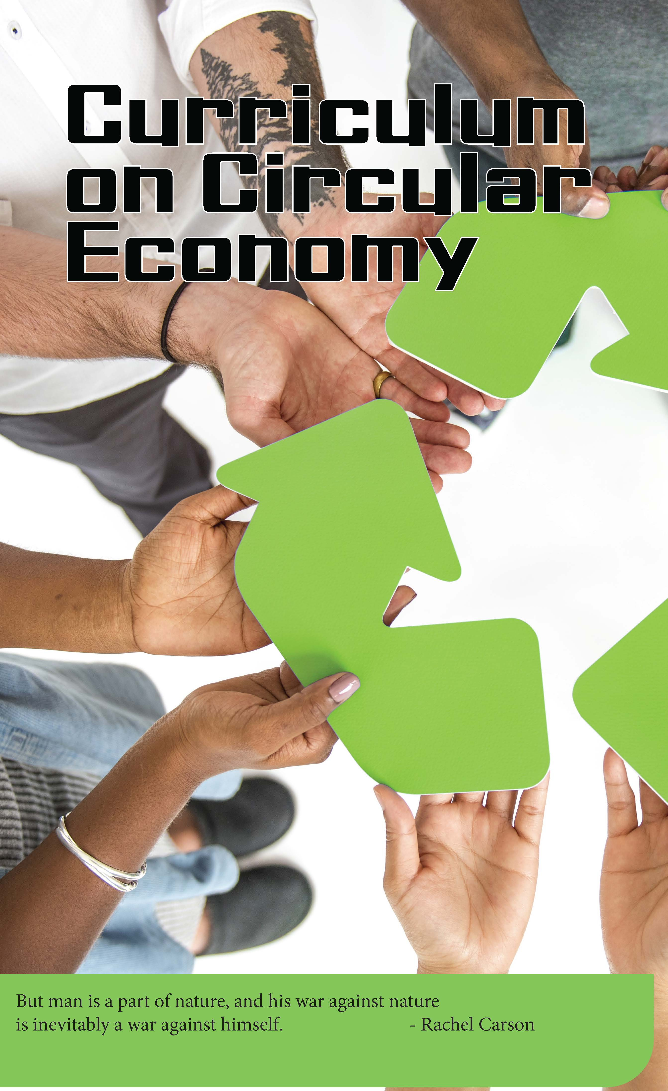
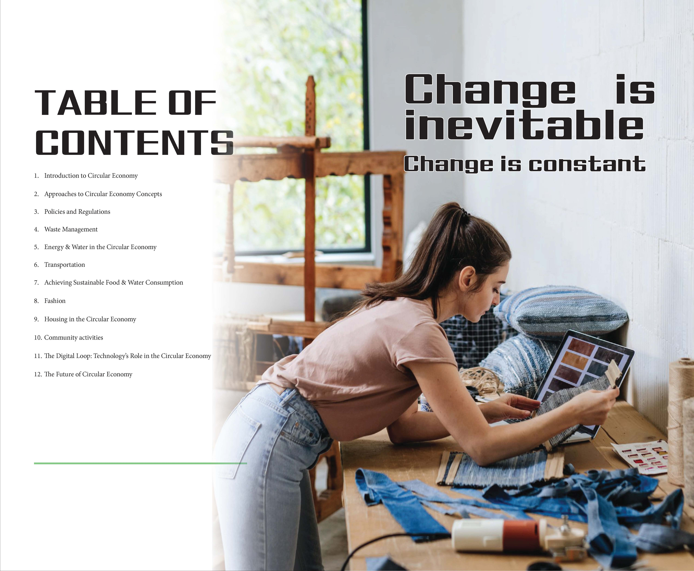

Slide 10
Experiential and Community-Based Learning
from knowledge to practice
young people apply knowledge they gained from the game and curriculum to actual local settings
guided by trained youth workers
"learning by doing" enables participants to facilitate a transition from broader principles into meaningful, actionable solutions
developing civic and social entrepreneurial skills
enabling to realize their own sustainability ideas

Slide 11
Project Intellectual Outputs and Dissemination Channels
Output | Target Audience | Primary Function | Dissemination Channel
CycleQuest Video Game | Youth, General Public | Gamified learning, Engagement | Free download on platforms like Steam
Comprehensive Curriculum | Youth Workers, Educators | Formalizing non-formal education | Educational Toolkit for facilitators
University Syllabus | University Lecturers, Students | Formal education integration | Consortium partner universities
Educational Toolkit | Facilitators, Mentors | Practical application, Mentorship | Consortium-specific distribution

Slide 12
Scalability and Long-Term Impact
The Synergy of an Integrated Approach
Durable tools: Free game, accessible curricula for long-term use
Empowers youth as informed, proactive agents of sustainability
Broader Implications and Future Directions
Potential to shape future educational frameworks
Pan-European collaboration ensures adaptability
Potential Challenges and Limitations
Measuring behavioral change
Integration into university systems

Slide 13
Thank you for your attention!
doc. PhDr. Jaroslav Mihálik, PhD.
jaroslav.mihalik@ucm.sk
https://www.circles-project.eu/sk

