Slide 1
Metropolitan cooperation – examples from the MECOG-CE project František Kubeš
Region in the Development of Society 2025 (RESPO)
Social, Political, Environmental and Public Administration Challenges
for the Visegrad Region
26th of September 2025, Brno, Czech Republic

Slide 2

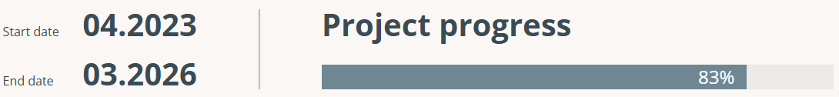
MECOG-CE = Strengthening MEtropolitan COoperation and Governance in Central Europe
The project aims to identify the best tools, procedures and examples of good practices for strengthening metropolitan cooperation and governance in Central Europe and apply them in metropolitan areas towards strengthening integrated metropolitan strategic and spatial development.

Slide 3

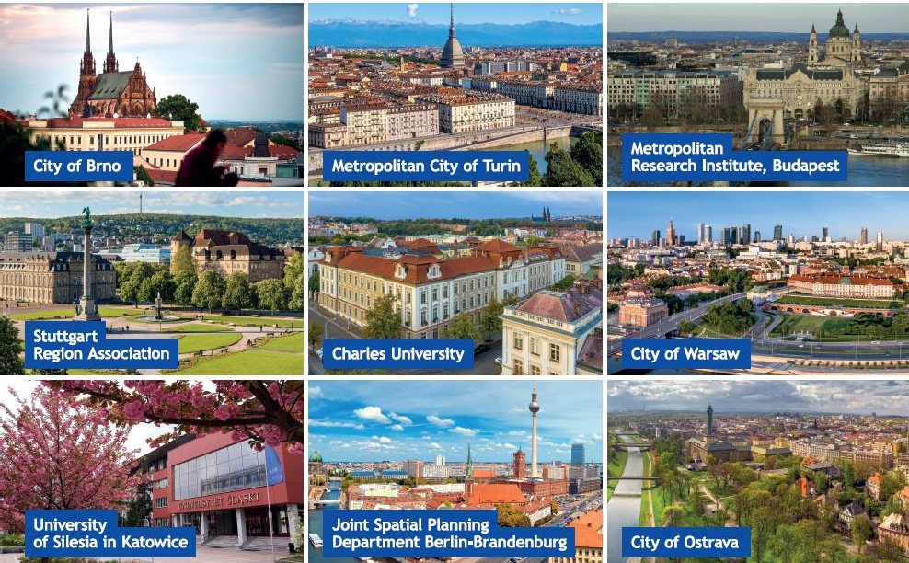


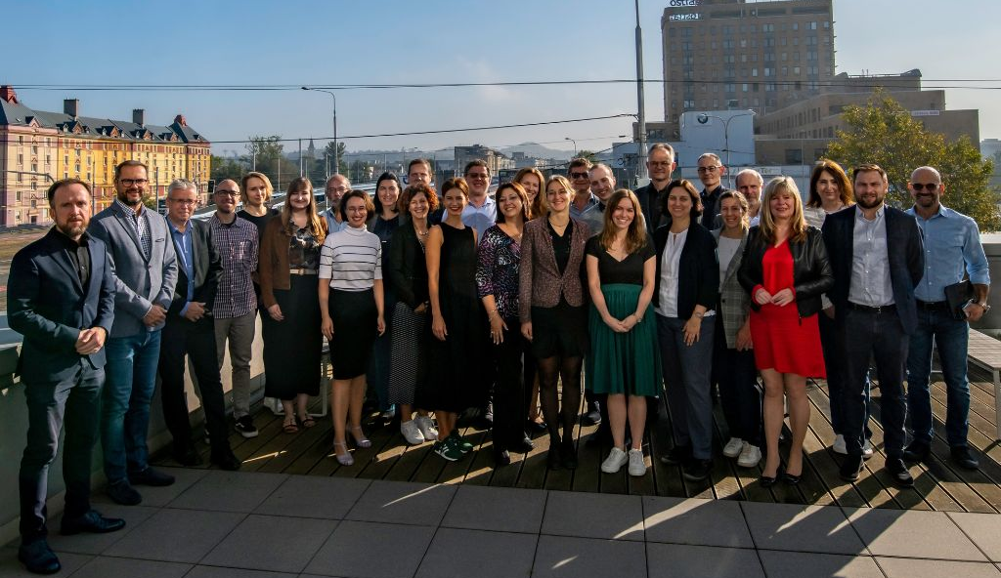

Project partners
2 universities
1 research institute
3 cities
3 metropolitan cities/areas
6 associated partners

Slide 4
MECOG-CE
WP 1
WP 2
WP 3
Analysis of metropolitan dimension
Capacity building towards pilot actions and new solutions
Strategy and action plans for strengthening metropolitan cooperation and governance
Common Vision for enhancing cooperation in Central European MAs
Study clusters
Pilot actions
New solutions
Strategy for strengthening metropolitan cooperation and governance in CE
Action Plans for MA

Slide 5
What has been already done?

Slide 6
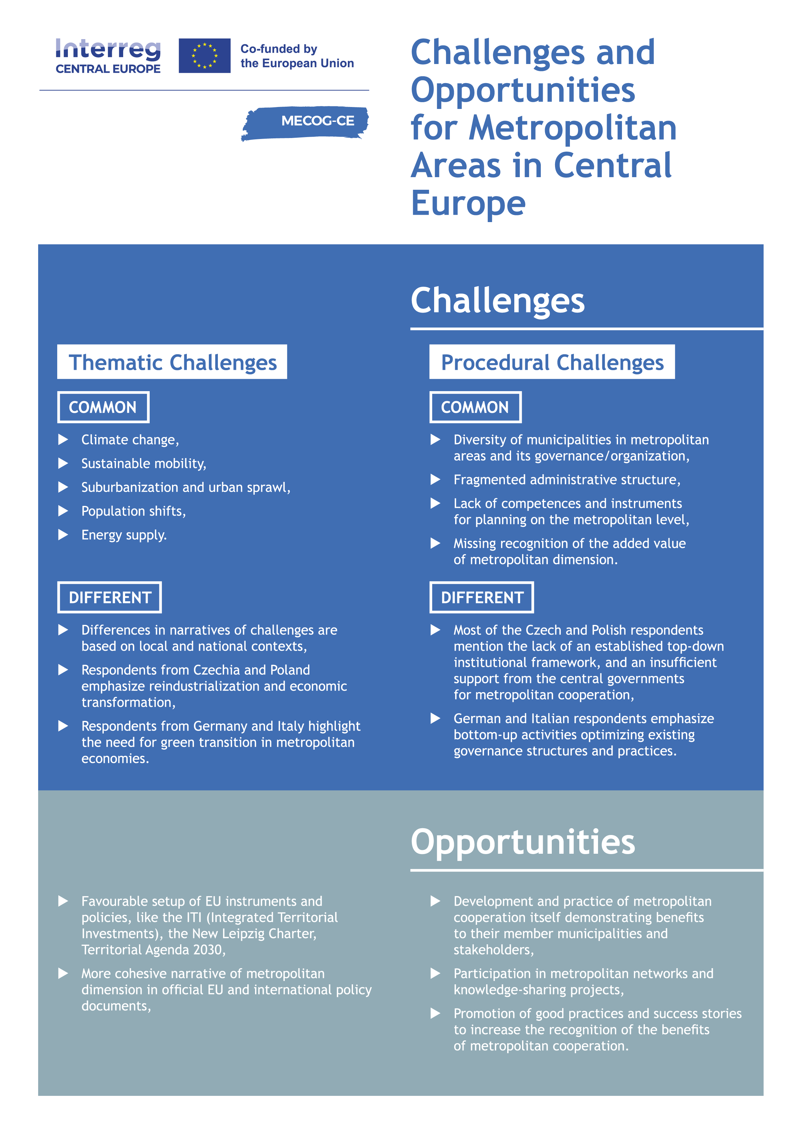
First steps
Analysis of metropolitan dimension
Challenges and opportunities of Central European metropolitan areas

Slide 7

First steps
Analysis of metropolitan dimension
Common
Metropolitan
Vision

Slide 8
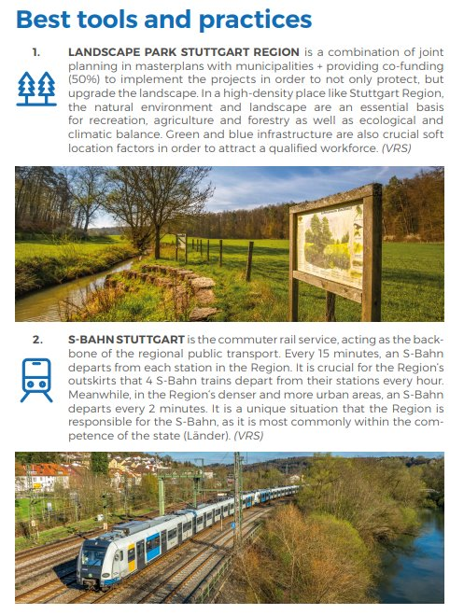
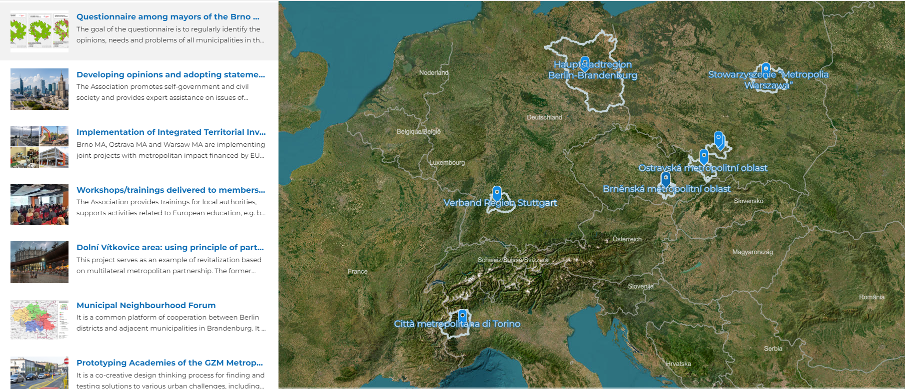
First steps
Analysis of metropolitan dimension
76
Best practices

Slide 9





From best practices to learning
Study clusters
Mobility and Planning/Transport Association (good practice example from Stuttgart Region and Berlin-Brandenburg)
Food Districts (good practice example of the Metropolitan City of Turin)
Warsaw Metropolitan Association (elaboration of joint opinions and workshops/trainings)
Prototyping Academies (example of good practice of the GZM Metropolis)
Semi-structures and dialogues to strengthen cooperation (Municipal Neighbourhood Forum and Questionnaire among mayors - examples of good practice from Berlin-Brandenburg and the City of Brno)

Slide 10
From learning to testing
Pilot actions
Possibilities of Integrating Bus Transport in the Warsaw Metropolis
Potential for food cooperation and its governance network in the Brno Metropolitan Area
Informal and participatory planning approach to the vision process for the Metropolitan Area Berlin-Brandenburg
Participatory approach to transforming metropolitan territories in the Ostrava Metropolitan Area and the Stuttgart Region
Structured dialogue for evaluating the strategic planning process in the Metropolitan City of Turin

Slide 11
From testing to implementing
New solutions
Cooperation platform for the development of metropolitan public transport
Food cooperation for metropolitan areas
Bottom-up process-oriented stakeholder involvement
Innovative Metropolitan Prototyping
Engaging metropolitan stakeholders in strategic planning process

Slide 12
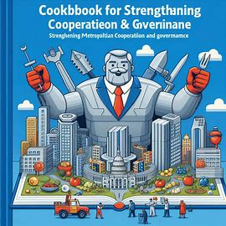

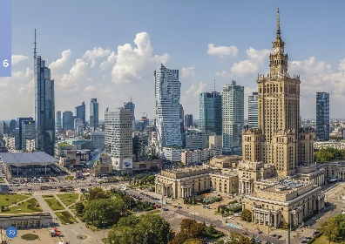
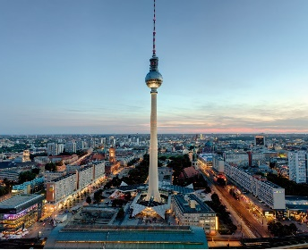
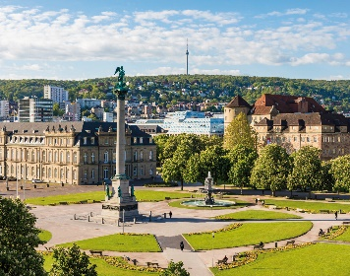

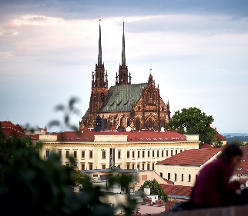
Final outcomes (in preparation)
Strategy for strengthening metropolitan cooperation and governance
Action plans for metropolitan areas involved

Slide 13
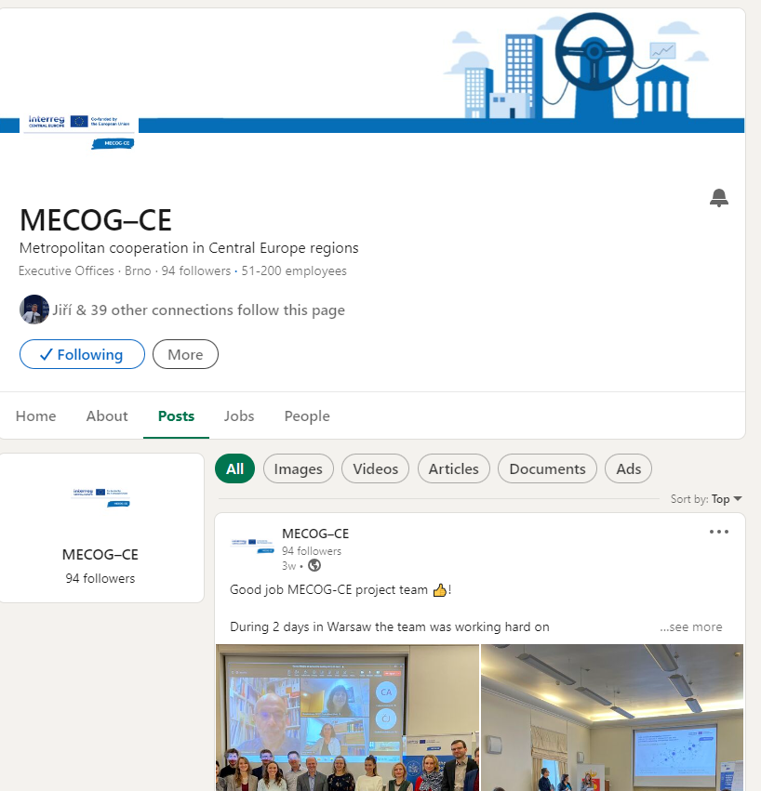
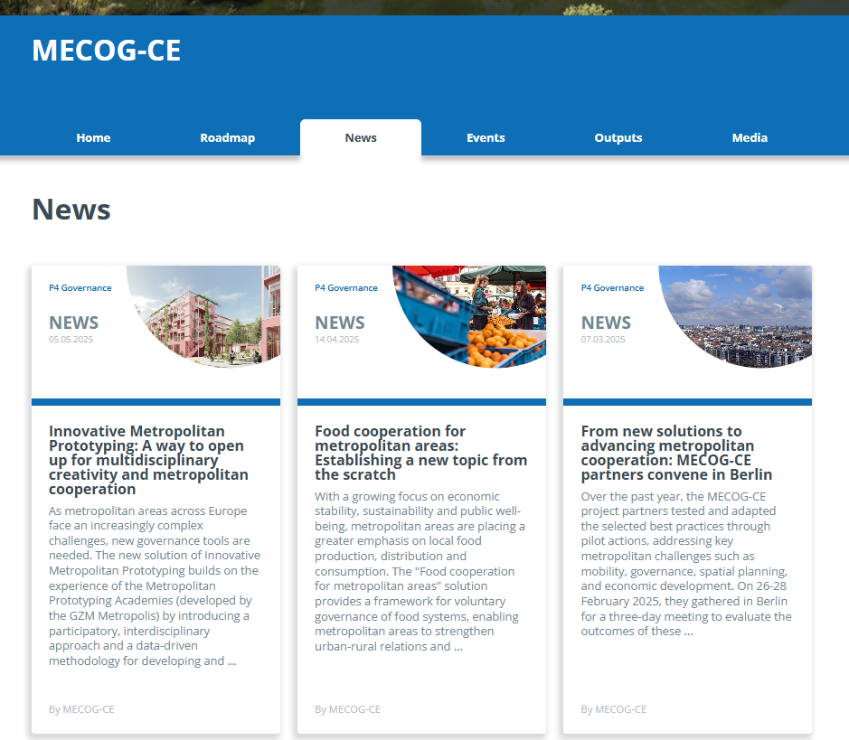
More information
Our website: https://www.interreg-central.eu/projects/mecog-ce
Follow our LinkedIN MECOG-CE

Slide 14
Thank you for your attention!

