Slide 1
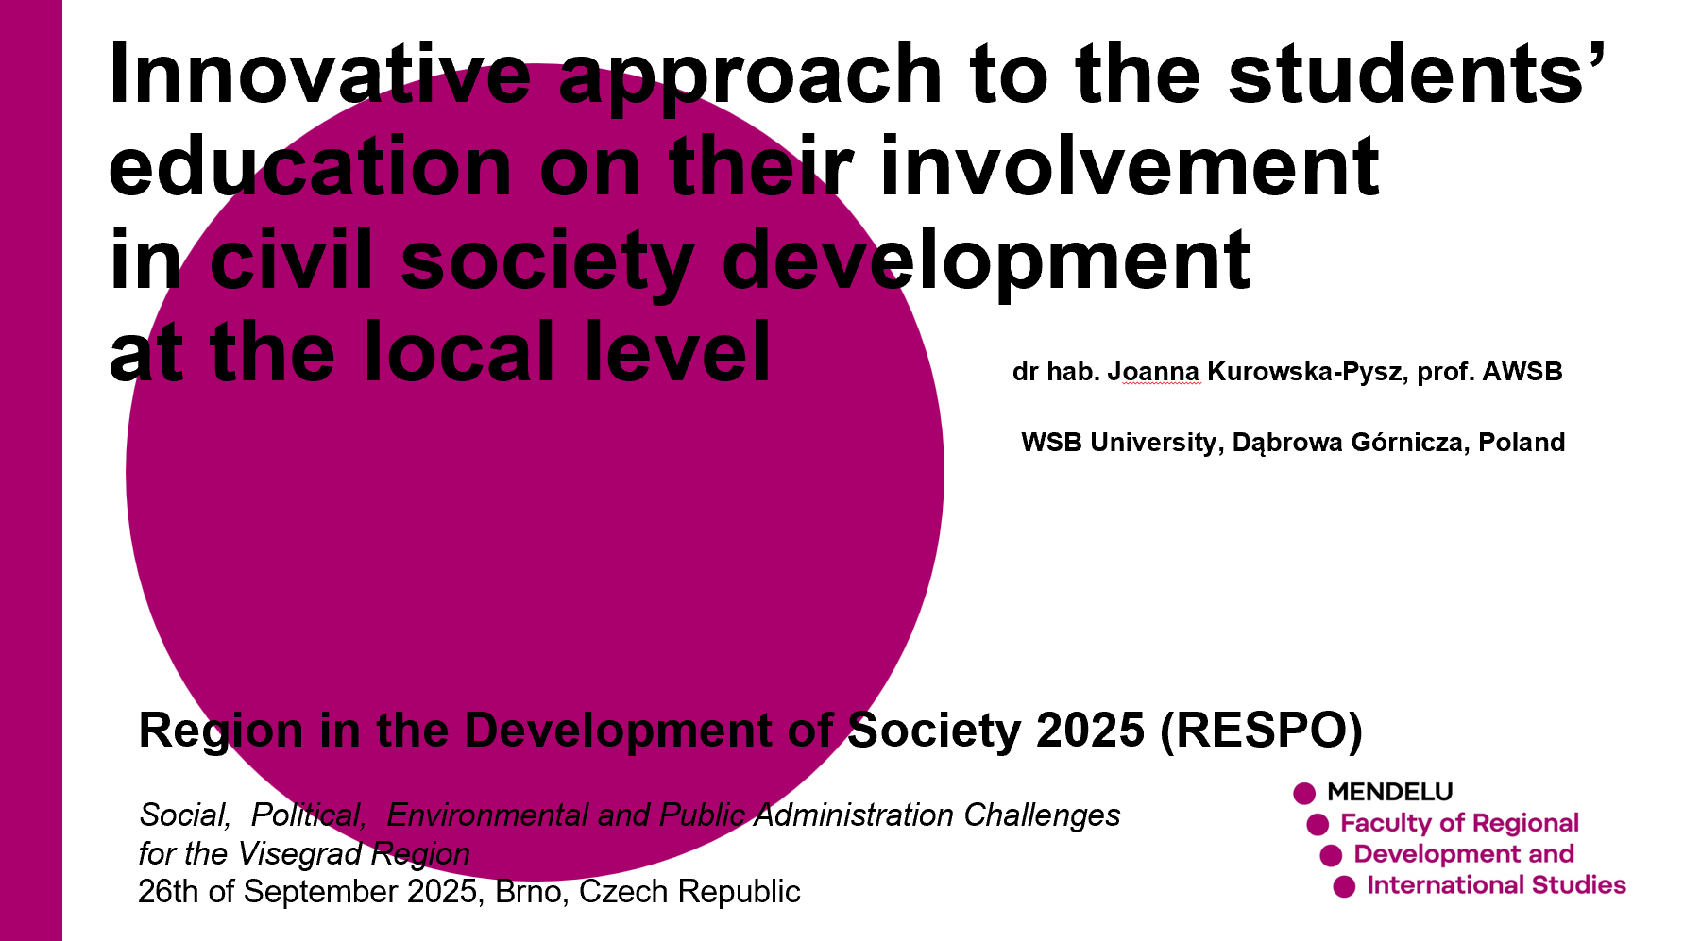

Slide 2


1. Theoretical background 2. Case study 3. Main findings 4. Preliminary conclusions and project outcomes
Agenda
Hcdsfdh
HEIsCITI HEIs as Innovative Triggers of Sustainable Development in European Cities in Post Covid-19 era

Slide 3
In the face of complex multidimensional transformations in European regions, active citizen involvement is essential for building inclusive and sustainable communities. Young citizens, in particular, are increasingly recognised as immediate agents of change, whose active involvement in decision-making represents a strategic investment in social capital and innovation. However, effective participation is often hindered by significant barriers, such as a perceived lack of real influence and low trust in public institutions. For engagement to be authentic, it must move beyond tokenistic gestures towards meaningful collaboration. Frameworks like the ‘Ladder of Participation’ provide a model for progressing from merely informing youth to establishing genuine partnerships where decision-making power is shared. By systematically incorporating the perspectives of young people into regional and local planning and development, as well as the co-governance of their communities, authorities can harness fresh ideas and digital fluency to co-create solutions, while fostering a lasting culture of civic responsibility and strengthening local democracy. Flanagan, C., & Levine, P. (2010). Civic engagement and the transition to adulthood. The future of children, 159-179. Percy-Smith, B. (2010). Councils, consultations and community: Rethinking the spaces for children and young people's participation. Children's Geographies, 8(2), 107-122. Goddard, J., Hazelkorn, E., & Vallance, P. (Eds.). (2016). The civic university: The policy and leadership challenges. Edward Elgar Publishing.
Theoretical Background / Citizens’ engagement at the local level

Slide 4

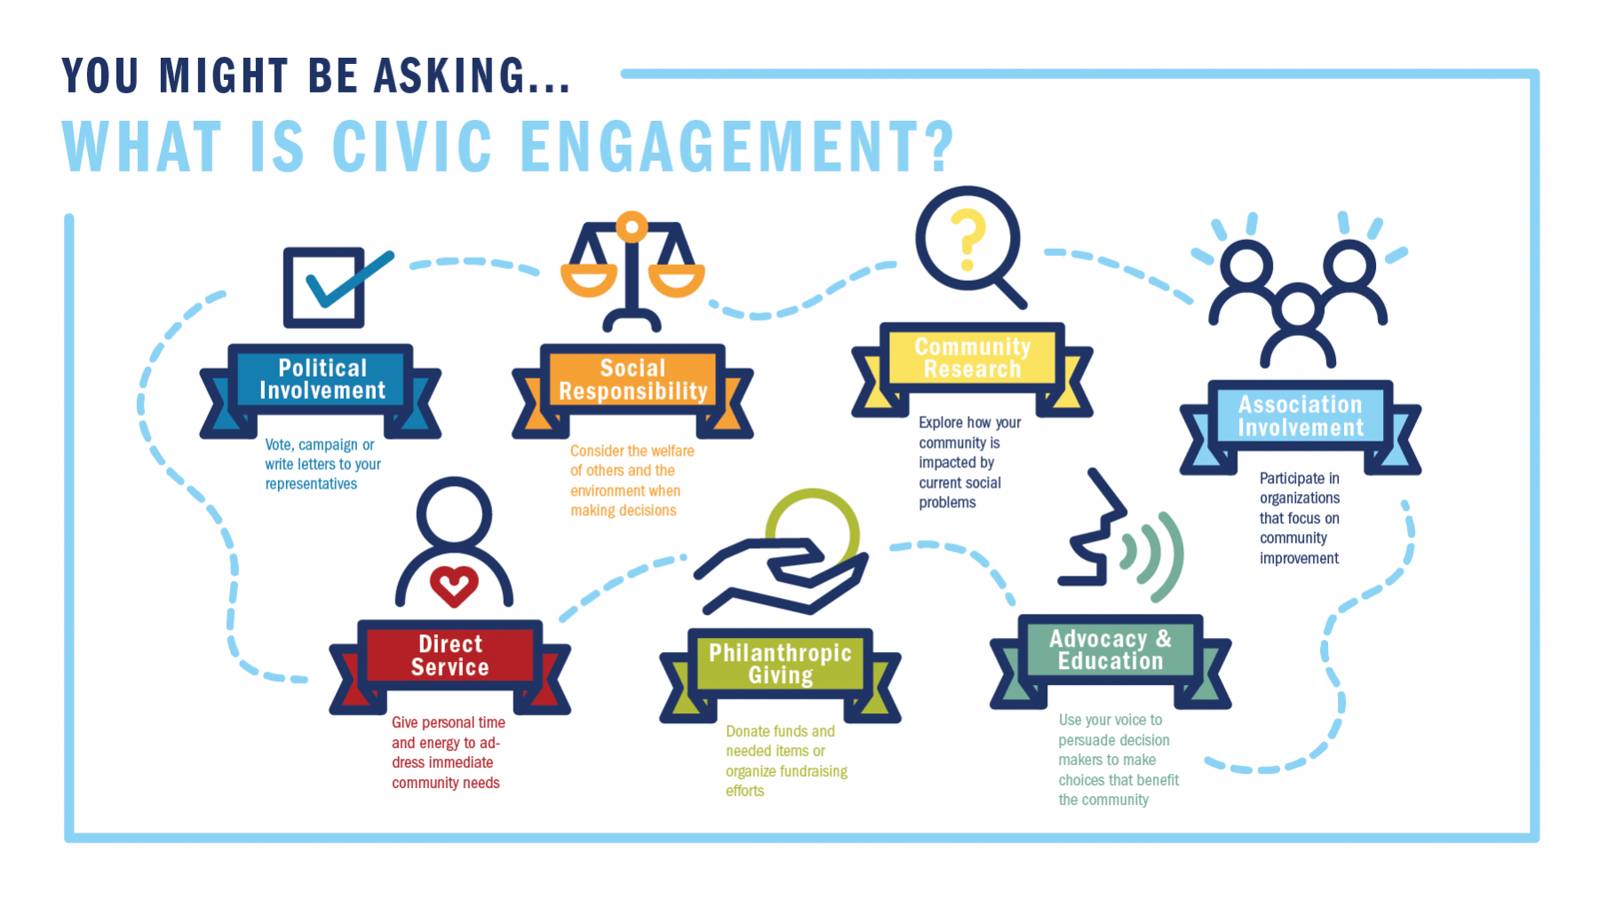
Theoretical Background / Participatory learning
instructional model promoting the active engagement of participants in the learning process, using various didactic strategies and techniques, such as group discussions, peer learning, role-playing games, observation of the learning object, use of learning outcomes in daily and professional life, evaluation of the learning action.
https://www.cedefop.europa.eu/en/tools/vet-glossary/glossary/participative-learning-participatory-learning
Principles
Collaboration
Engagement
Benefits
Enhancing Engagement and Motivation
Improving Knowledge Retention
Challenges
Navigating Resistance to Change
Ensuring Inclusivity and Equity
Shared Responsibility
Fostering Collaborative Skills
Varying learning paces
https://advancetitan.com/spotlight/2023/10/04/uw-system-calls-for-civic-engagement-among-students
Key Message: Both participatory learning and civic engagement are crucial for transition of young people into active citizens equipped to contribute positively to their communities.
By Claire Anderson, https://focuskeeper.co/glossary/what-is-participatory-learning/

Slide 5
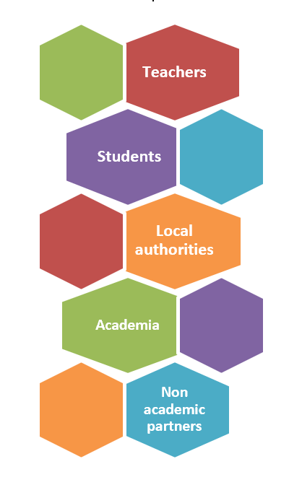
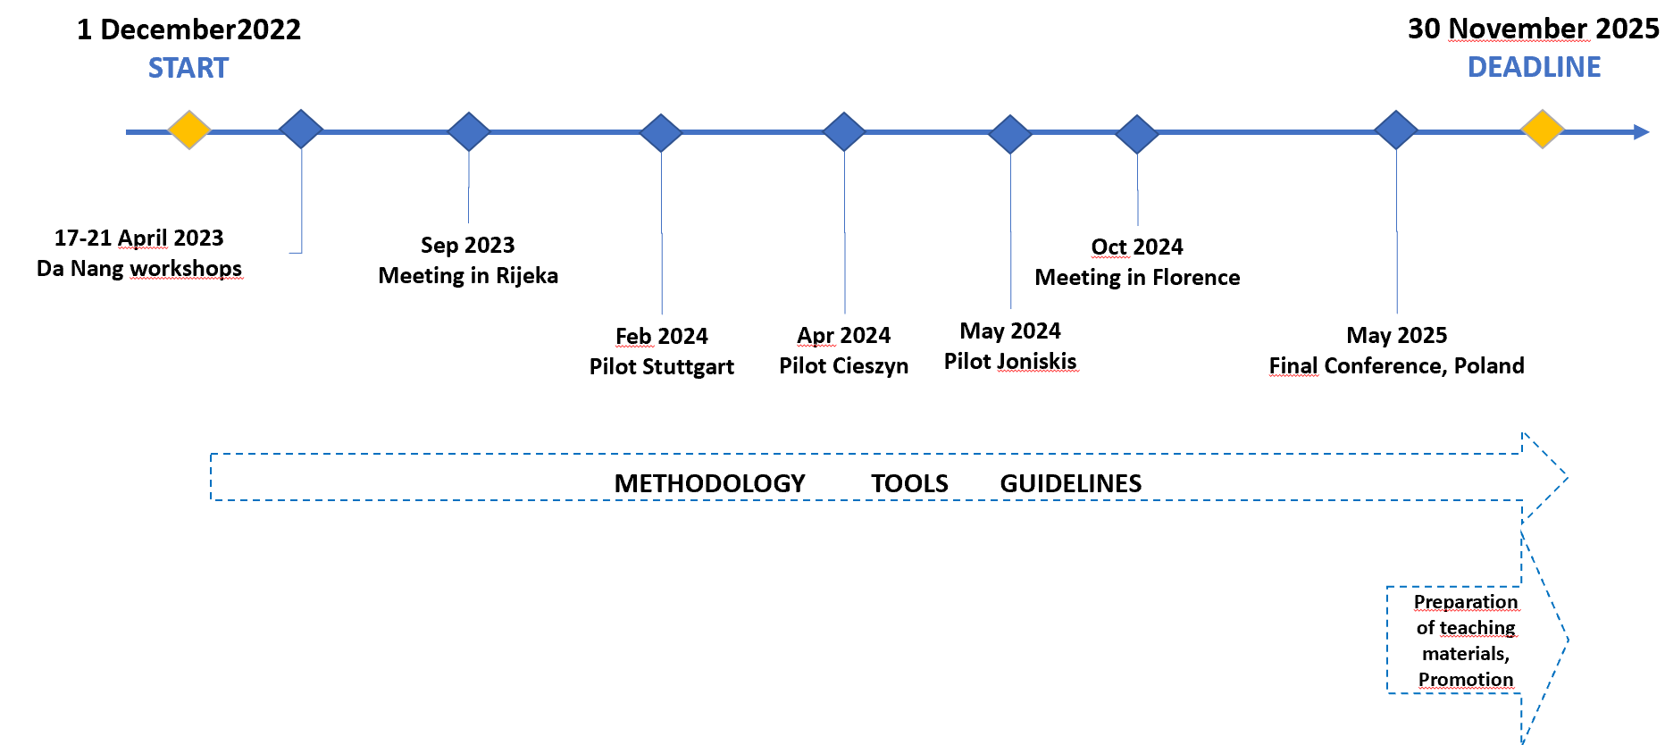
Case Study Assumptions
The HEIsCITI project focuses on designing, testing and validating universal curricula (methodology and teaching tools) for academic and secondary school courses to teach students how to animate, coordinate, and contribute to communication between citizens and local authorities for inclusive and sustainable urban development in the post-COVID-19 era.
Program: Erasmus+Cooperation partnerships in higher education
Project ID: KA220-HED-96EB51E1

Slide 6
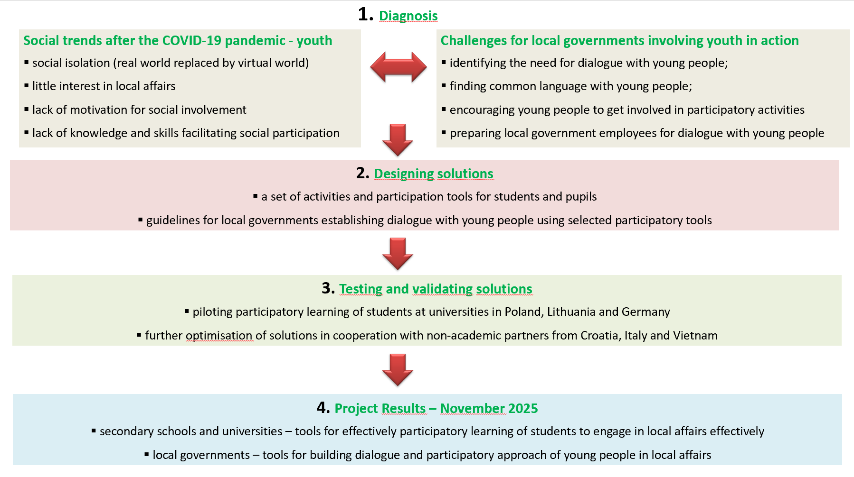
Project Methodological Approach

Slide 7
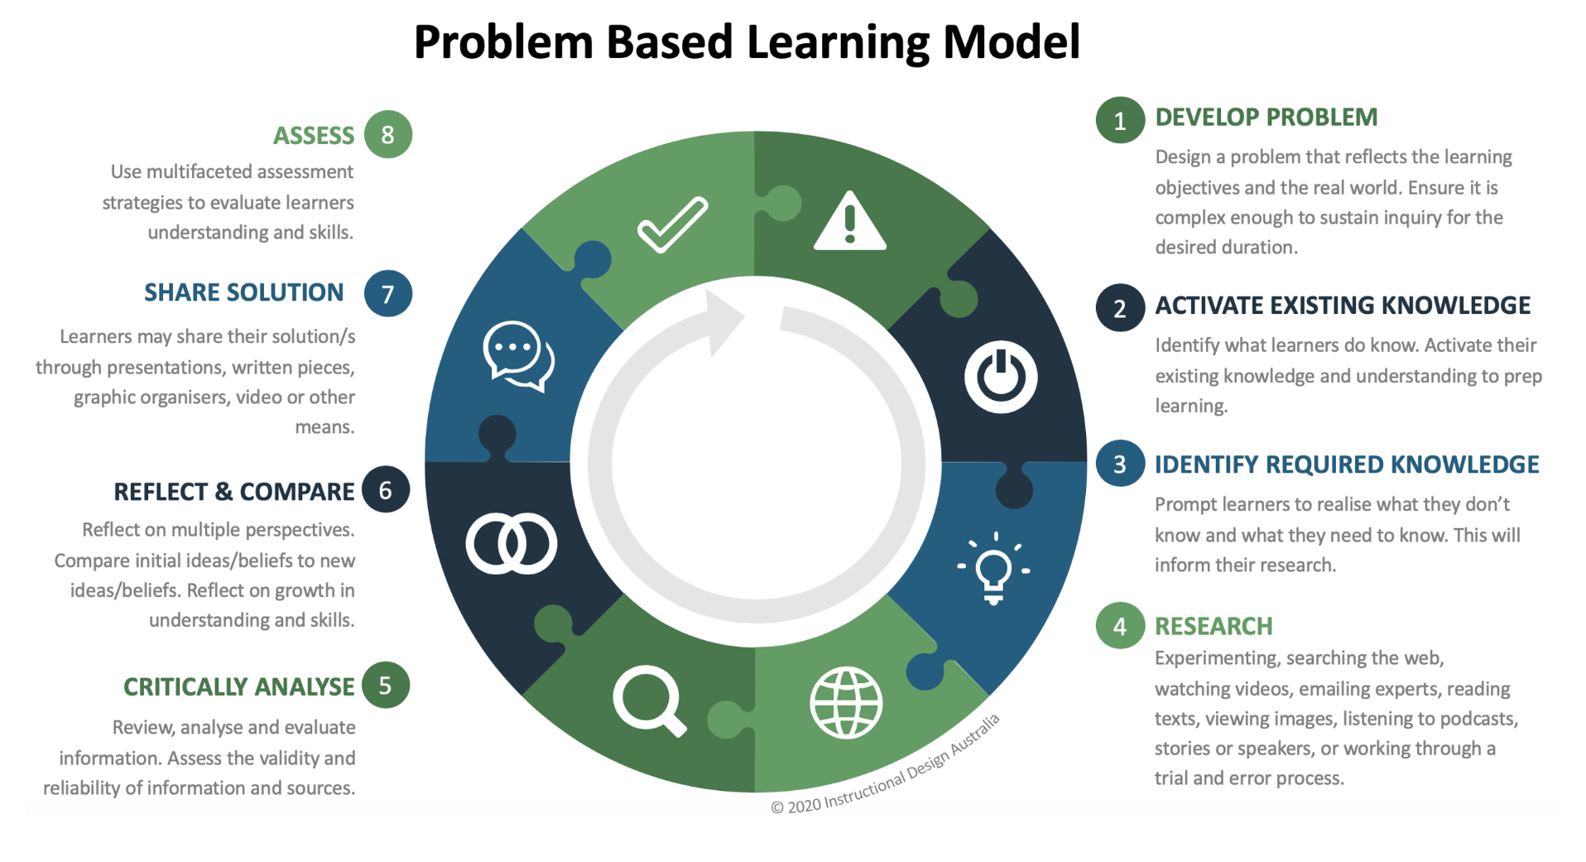
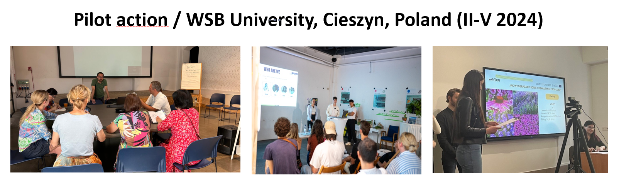
Case Study
Educational approach: Problem based learning 40-hour course: 15-h lecture and 25-hour workshop; plus 10-hour of individual students work – 2 ECTS
Educational method: Problem Based Learning Participatory tools: walk&talk, observations, interviews, brainstorming, Charette workshop
Problem:
Boosting abandoned areas – co-creation of revitalization projects
Process:
50 students, 2 teachers, 10 external stakeholders – representatives of self-government, SMEs, NGOs, local community
Source: https://instructionaldesign.com.au/pbl/

Slide 8
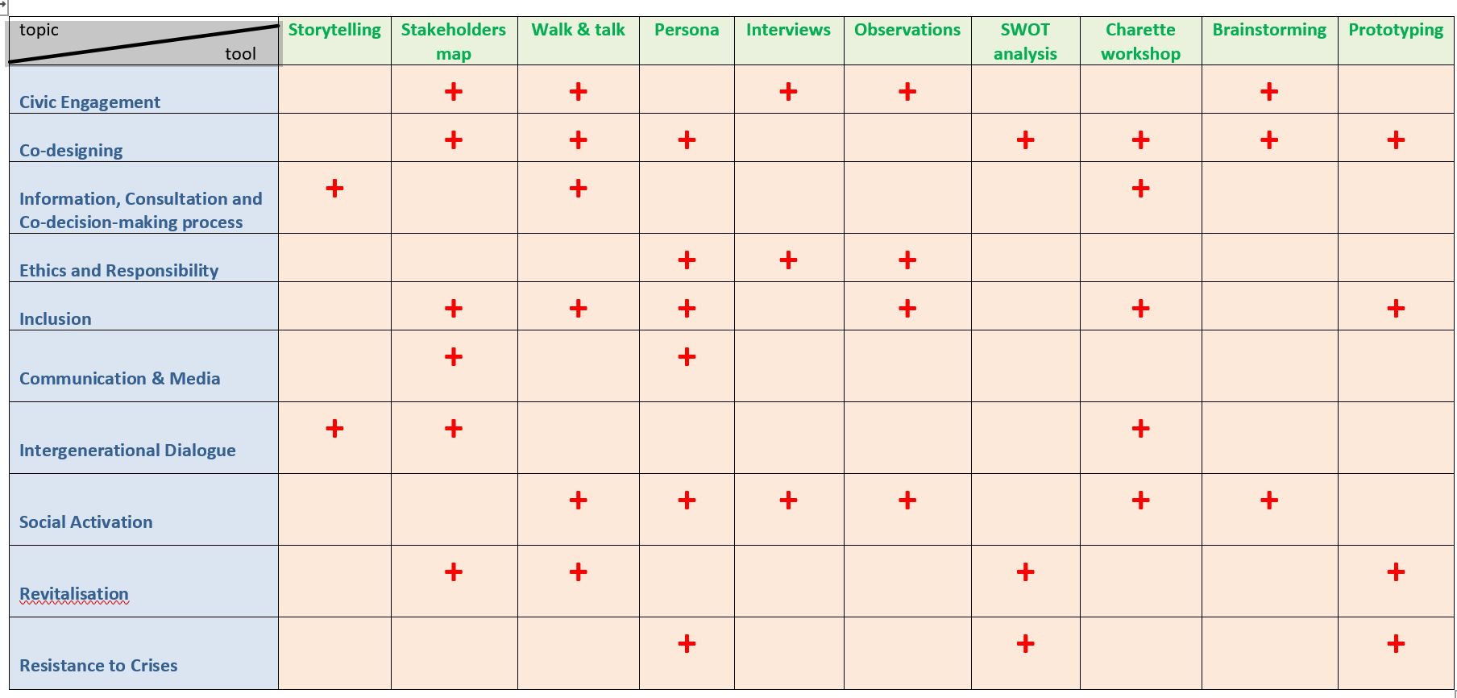
Main Findings – correlations among topics & educational/participatory tools implemented within 3 pilot actions: Poland, Germany, Lithuania

Slide 9
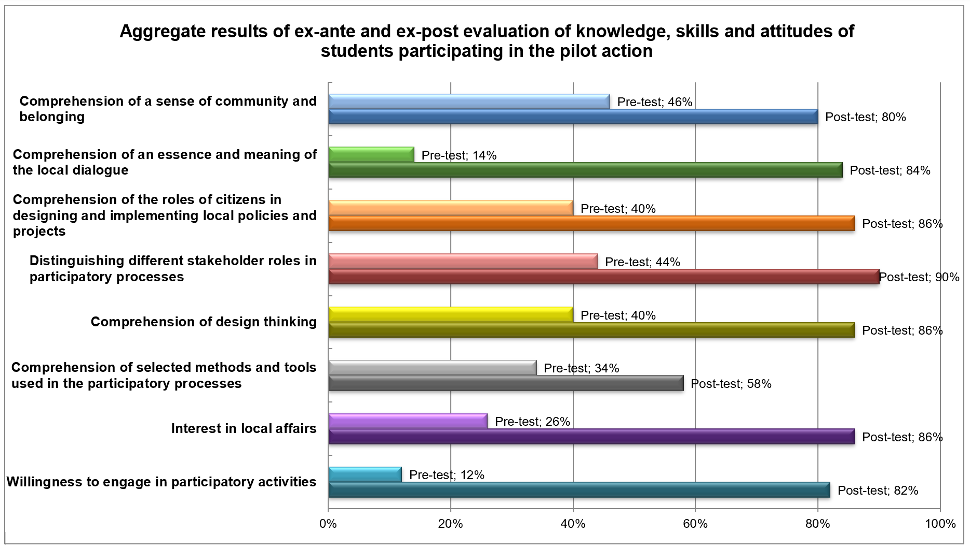
Main Findings – progress in knowledge and skills of students participating in the pilot action in Poland

Slide 10
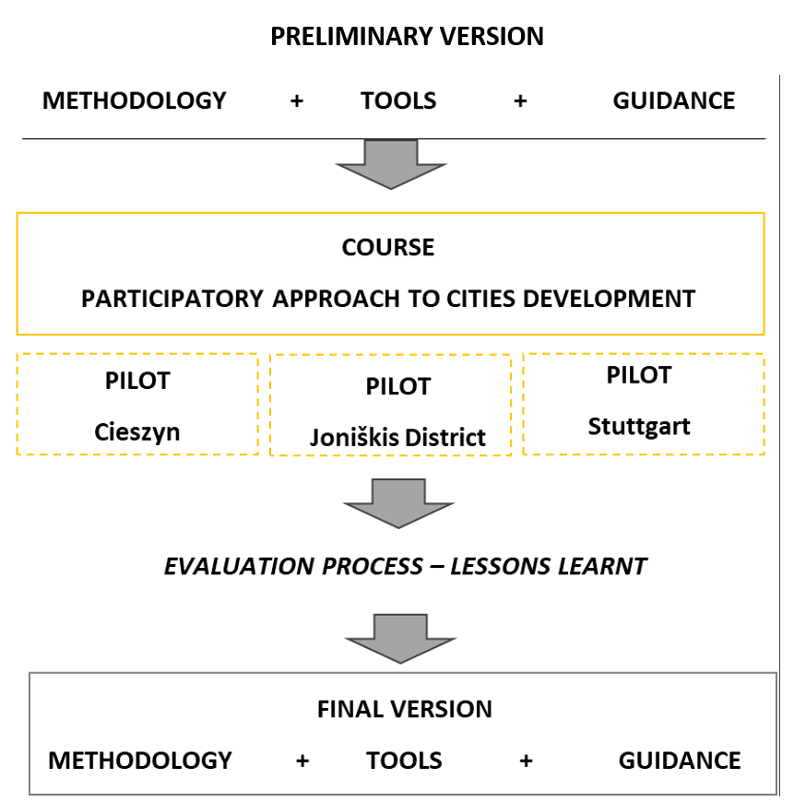
Preliminary conclusions
Providing students with good conditions for participatory learning is a very challenging and demanding process. It exceeds standard learning requirements, therefore, students should be well-motivated to participate in this proces and see the benefits for themselves.
This is particularly crucial when designing curricula and introducing a new course. considering several iterations and constant It requires outstanding competencies and creativity from teachers who should also collaborate with external stakeholders e.g. self-governments.
Participatory learning focused on involving students in local projects and strategies development requires a clear message about the purpose of their engagement.
Therefore, in this educational project, manuals provided both for teachers and external stakeholders are being prepared, tested and validated together, providing a multi-dimensional view and assessment.
The final version of the project outcomes (manuals) will be approachable at te project website in December 2025.
More information: https://wsb.edu.pl/heisciti/about-the-project

Slide 11
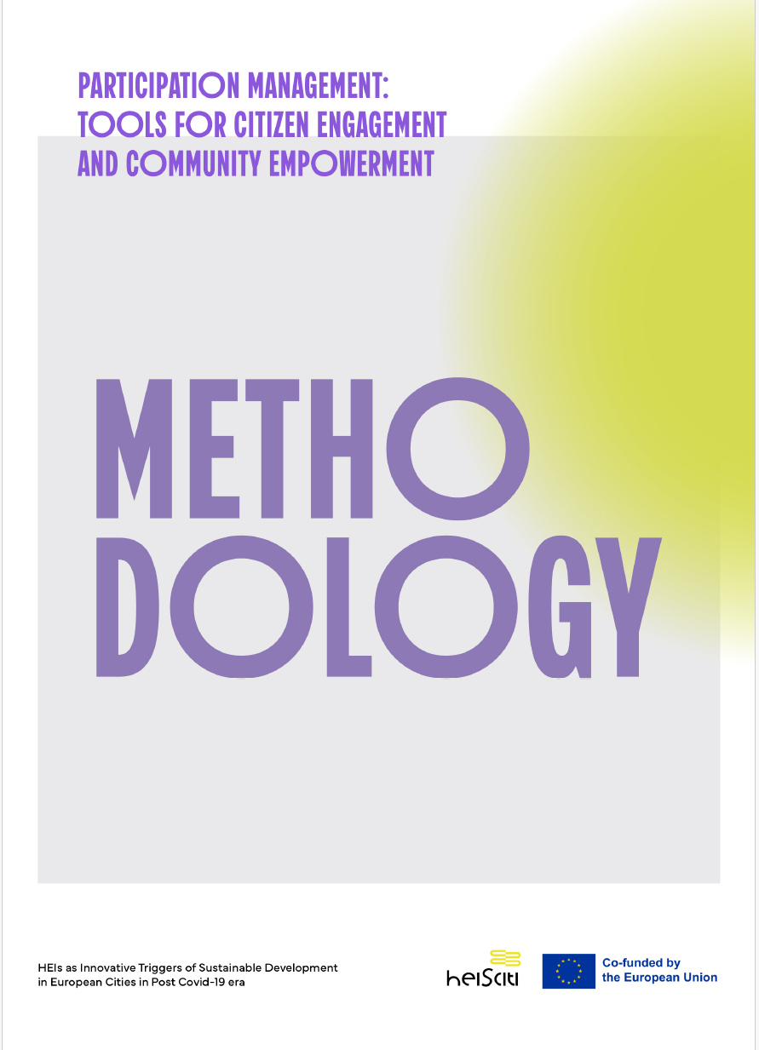
Teaching Methodology
The course aims to teach students and secondary school students how to facilitate effective communication between citizens, particularly youth, and local authorities, promoting sustainable urban development.
The primary objective of the course is to foster students’ active involvement in community development by establishing partnerships among various stakeholders in community engagement. This, in turn, will influence urban policy and practice, moving towards a system that emphasises shared decision-making through improved information, communication, and dialogue.
The objectives of the course are as follows:
defining the concept of community engagement
providing variability of tools to enable responsible participation in local contexts
guiding students in the process of designing and implementing projects or plans that address specific community needs
It employs Project-Based Learning (PBL) and Design Thinking, combining theoretical knowledge with practical, hands-on projects.
More information: https://wsb.edu.pl/heisciti/about-the-project

Slide 12


Toolkit on citizens’ engagement at the local level
The adaptable toolkit is designed for lecturers and facilitators (practitioners) to foster effective community and academic engagement in local democracy.
This guide provides scenarios (lectures and workshops) and tools for social dialogue. It uses design thinking and project-based learning methodologies.
The course is founded on Project-Based Learning (PBL) and Design Thinking methodologies.
It can be useful for self-governments organising public consultations as well as for scholars and NGOs that conduct some social exercises with students.
These student-centred approaches engage students in active problem-solving and research on complex, real-world tasks.
This process develops critical soft skills, including teamwork, communication, creative thinking, and problem-solving.
More information: https://wsb.edu.pl/heisciti/about-the-project

Slide 13
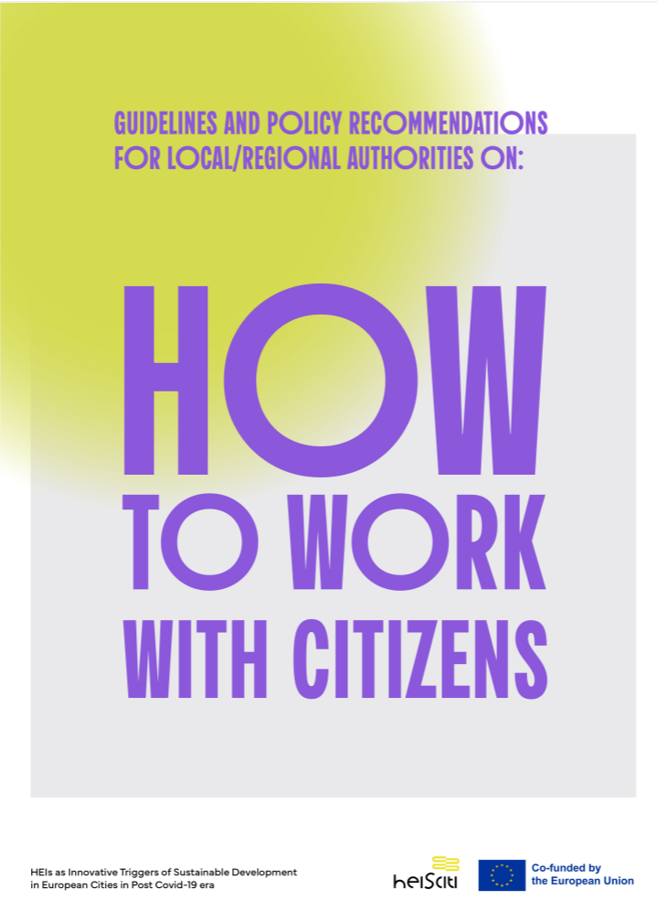
Citizens’ engagement guidelines for self-governments
It provides local and regional authorities with a comprehensive framework for engaging citizens, especially youth and HEIs, in sustainable urban development. It highlights the strategic importance of transforming citizens from passive service recipients into active co-creators of public policy to enhance social cohesion, trust, and innovation.
A key theme is the crucial role of HEIs as innovation hubs that bridge research and governance.
It outlines strategies for building structured, long-term partnerships among self-governments and with universities to ensure urban planning is evidence-based and forward-thinking.
It offers a practical roadmap for strengthening youth engagement, covering diagnosis, strategic planning, implementation, and monitoring.
Finally, it presents a toolkit of participatory methods, including storytelling, stakeholder mapping, and prototyping. It also details the necessary competencies and resources for authorities, emphasizing the need for a supportive ecosystem to ensure engagement is effective and sustainable
More information: https://wsb.edu.pl/heisciti/about-the-project

Slide 14
Thank you for your attention!
jkurowska@wsb.edu.pl

